Slide 1
Document Summarization
By
Naga Yashwanth Bodduluri Thriloknadh kandimalla Upender Boddu

Slide 2
Project objective
This project stands for Automatic text summarization, is the task of producing a concise and fluent summary while preserving key information content and overall meaning.

Slide 3
Text summarization
Simply cutting down a sentence's word count while maintaining its sense is text summarizing. We have a variety of methods for extracting information from raw text data and using it as a model for summarization.
These are broadly two different approaches that are used for text summarization
Extractive Summarization
Abstractive Summarization

Slide 4
Goal
The goal of this project is to text summarization models based on summaries for one or many documents at a time.
The model we use for training or fine-tuning is Transformers BART or T-5, of better performance.
fine-tuned BART model can take a text sequence as input and produce a different text sequence at the output.

Slide 5
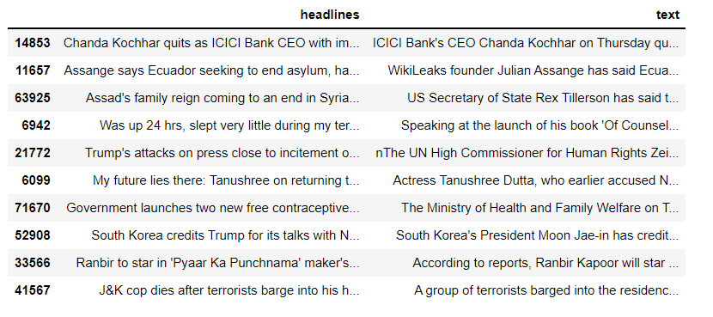
Data set
We create custom datasets from university websites and the data is collected using web scraping
https://drive.google.com/file/d/14Dut_GZrLbLeVAWS3QL861HJ0Zdb5Of2/view

Slide 6
Implementation
Bart architecture
We will use a model that already has been pre-trained to generate summaries
Transfer Learning allows us to create another baseline which will be useful to see what happens when we train the model on our dataset.
After that, it is time to use a pre-trained model and train it on our own dataset.
Once we have trained the model, we will use it to create summaries.
BART is a sequence-to-sequence model trained as a denoising autoencoder.

Slide 7
Evaluation methodology
The metric that is used most often in text summarization to measure the quality of a model is the ROUGE score.
ROUGE-N measures the number of matchings ‘n-grams’ between our model-generated text and a ‘reference’.

Slide 8
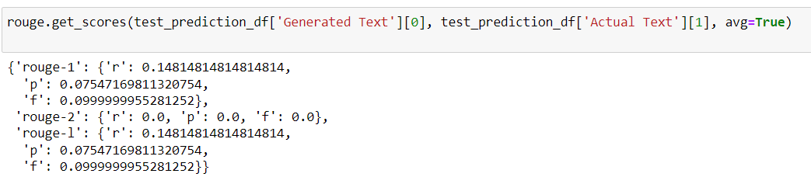
Results
In Conclusion we are using ROUGE score to calculate the matching words under the total count of words in reference sentence(summarisations). Furthermore, the ROUGE score ranges from 0 to 1, if it is 1 it means sentences are exactly matched the same. Otherwise it means it’s not matched exactly.

Slide 9
references
https://github.com/huggingface/transformers
https://towardsdatascience.com/text-summarization-with-nlp-textrank-vs-seq2seq-vs-bart474943efeb09

